Slide 1
Java Fullstack Development (Course Overview)
JAVA
HIBERNATE
SWING
MVC
SPRING
JUNIT
MySQL
Kabiraj Shrestha
Java Instructor

Slide 2
Coverage
Environment Setup
Introduction to Java
Introduction to MySQL and JDBC
Hibernate ORM Framework
Introduction To Swing
Web Application
Introduction To Spring Framework
Spring Boot
Spring Security
Microservice Architecture
Testing

Slide 3
Learning Methodology
Interactive sessions for feedback and questions
Hands-on experience with project-based learning
Career support for full-stack development
Real-world projects for building your portfolio
Personalized feedback to improve skills
Access to resources including code snippets, documentation, examples and Recorded Videos

Slide 4
Projects
A minor project on swing UI
A minor project on Java Web Application with basic CRUD Operation with MySQL
A major project, a full fledge e-commerce application with Springboot, Rest API’s, Thymeleaf, Spring Security, Microservice Design Pattern…
One of each to be submitted by the students as well.

Slide 5
Environment Setup
Install JRE
Install JDK
Install IDE
Install MySQL/Xampp

Slide 6
JRE java Runtime Environment
The Java Runtime Environment (JRE) is software that Java programs require to run correctly.
The JRE is the underlying technology that communicates between the Java program and the operating system.
Download Link: https://www.java.com/en/download/

Slide 7
Step 1 - Download the Java Install File to Your Computer
A supported version of Java will need to be downloaded to your computer before it can be installed. Please refer to the Oracle website or another provider to download a supported version.

Slide 8
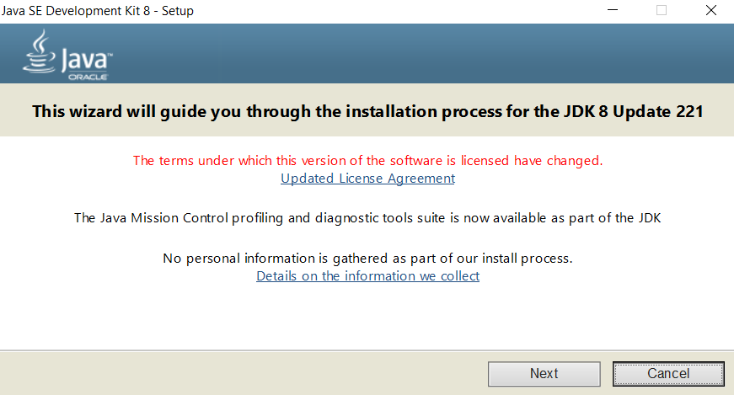
Step 2 - Install Java on your Computer
Double click on the Java install file within your Downloads folder.

Slide 9
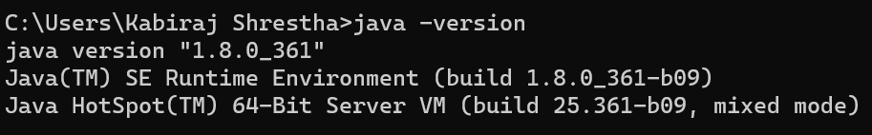
Step 3 – Confirm Java Installed Correctly
Open Command Prompt/Windows Powershell and type:
Java –version
If something like above is seen, you are good to go…

Slide 10
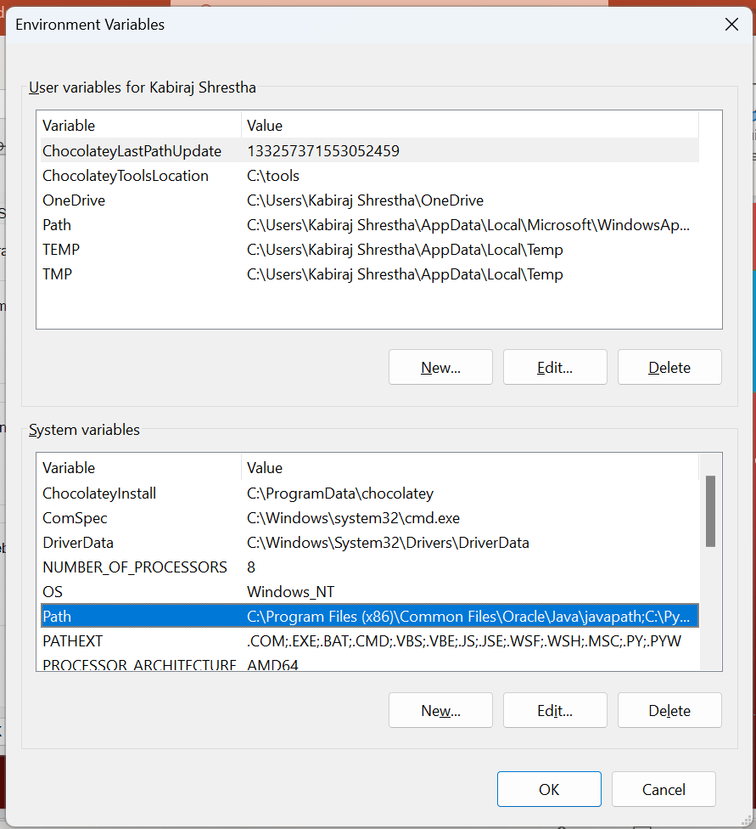
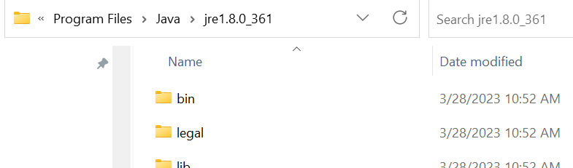
Step 4 – Else, Confirm java path is added to system variables:
Go to: control panel / system / advanced system settings / environment variables / system variables / Path and add the jre path:

Slide 11
JDK is a bundle of software development tools and supporting libraries combined with the Java Runtime Environment (JRE) and Java Virtual Machine (JVM)
Download Link: https://www.oracle.com/java/technologies/downloads/
JDK Java development kit

Slide 12
IDE integrated Development Environment
An integrated development environment (IDE) is a software application that helps programmers develop software code efficiently.
It increases developer productivity by combining capabilities such as software editing, building, testing, and packaging in an easy-to-use application.

Slide 13
IDE Options
Spring Tool Suite
https://spring.io/tools
Eclipse EE
https://www.eclipse.org/downloads/packages/
Intellij IDEA
https://www.jetbrains.com/idea/download/#section=windows
Visual Studio Code
https://code.visualstudio.com/download

Slide 14
the most popular Open Source SQL database management system, is developed, distributed, and supported by Oracle Corporation.
Download Link: https://dev.mysql.com/downloads/mysql/
MySQL

Slide 15
React
Node LST version
https://nodejs.org/en/download

Slide 16
Conclusion
Comprehensive understanding of Java Programming Language and Spring Ecosystem
Skills and confidence for pursuing web development careers
Two practical projects for building your portfolio
Interview Ready teaching learning Approach

